Slide 1


CS3003: OOP Basics
Pointers

Slide 2
Pointers
They are like any other types
Which means? …

Slide 3
Pointers
They are like any other types
Which means? …
They have a range of valid values and a set of valid operations that can be performed on those values

Slide 4
Pointers
Values?
Operations?

Slide 5
Pointers
Values – All valid memory addresses
Operations – Assignment, Dereference, Addition and Subtraction

Slide 6
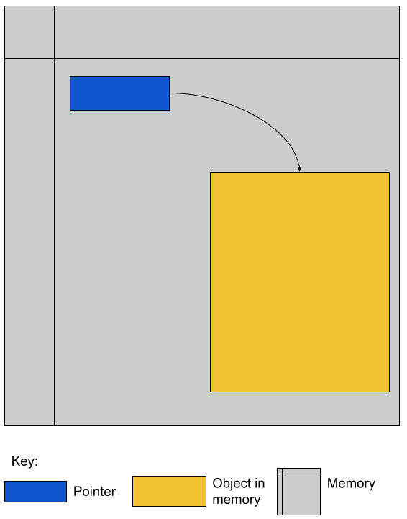
Pointers

Slide 7
Pros of pointers
Power of indirection
Power to address and manage heap dynamic memory

Slide 8
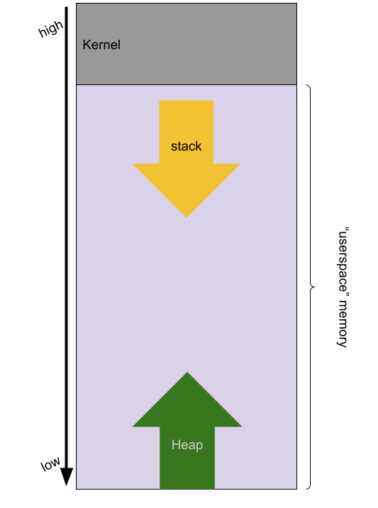
Heap Dynamic Memory

Slide 9
Cons of pointers
Pointer points to an area of memory that does not contain an object of the expected type
Pointer targets an area of memory inaccessible to the program

Slide 10
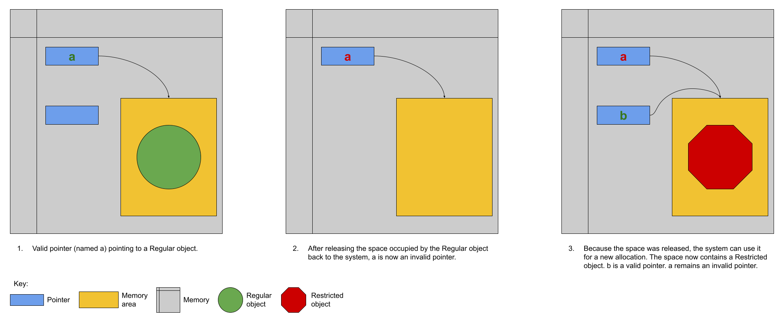
Cons of pointers

Slide 11
Possible solutions
Pointers to areas of memory that have been deallocated cannot be dereferenced.
The type of the object at the target of a pointer always matches the programmer's expectation.

Slide 12
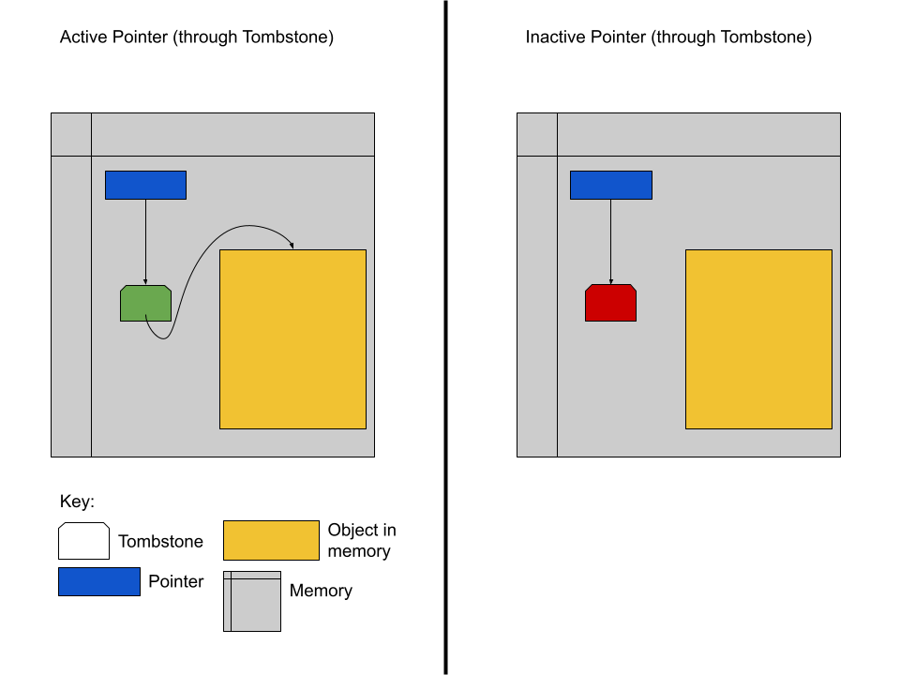
Tombstones

Slide 13
Problems with Tombstones
Once a tombstone has been allocated to protect a particular pointer it cannot be reclaimed.
Additional memory accesses add up!

Slide 14
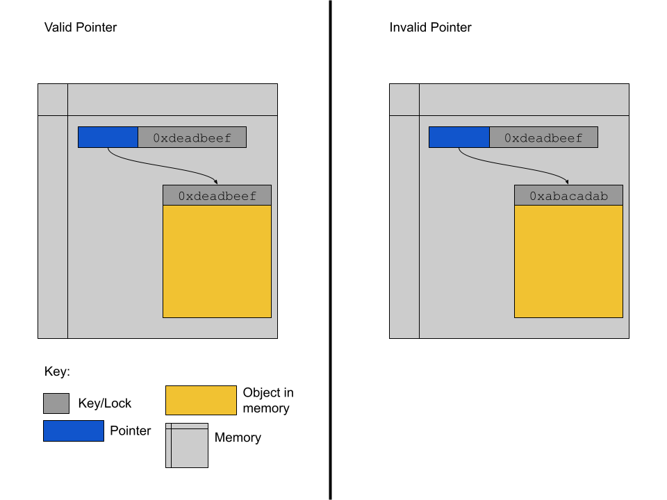
Lock and Key

Slide 15
Problems with Lock and Key
Speed cost
Space cost

Slide 16
Problems with Lock and Key
Speed cost
Space cost – why not make the keys smaller?

Slide 17
Problems with Lock and Key
Speed cost
Space cost – why not make the keys smaller? – Fewer unique key values

Slide 18
Dynamic Memory Management
Memory is a finite resource
Memory allocated on the heap must be deallocated
If an application cannot reach the allocated memory, it is leaked

Slide 19
Preventing memory leaks
Reference counting
Garbage collection

Slide 20
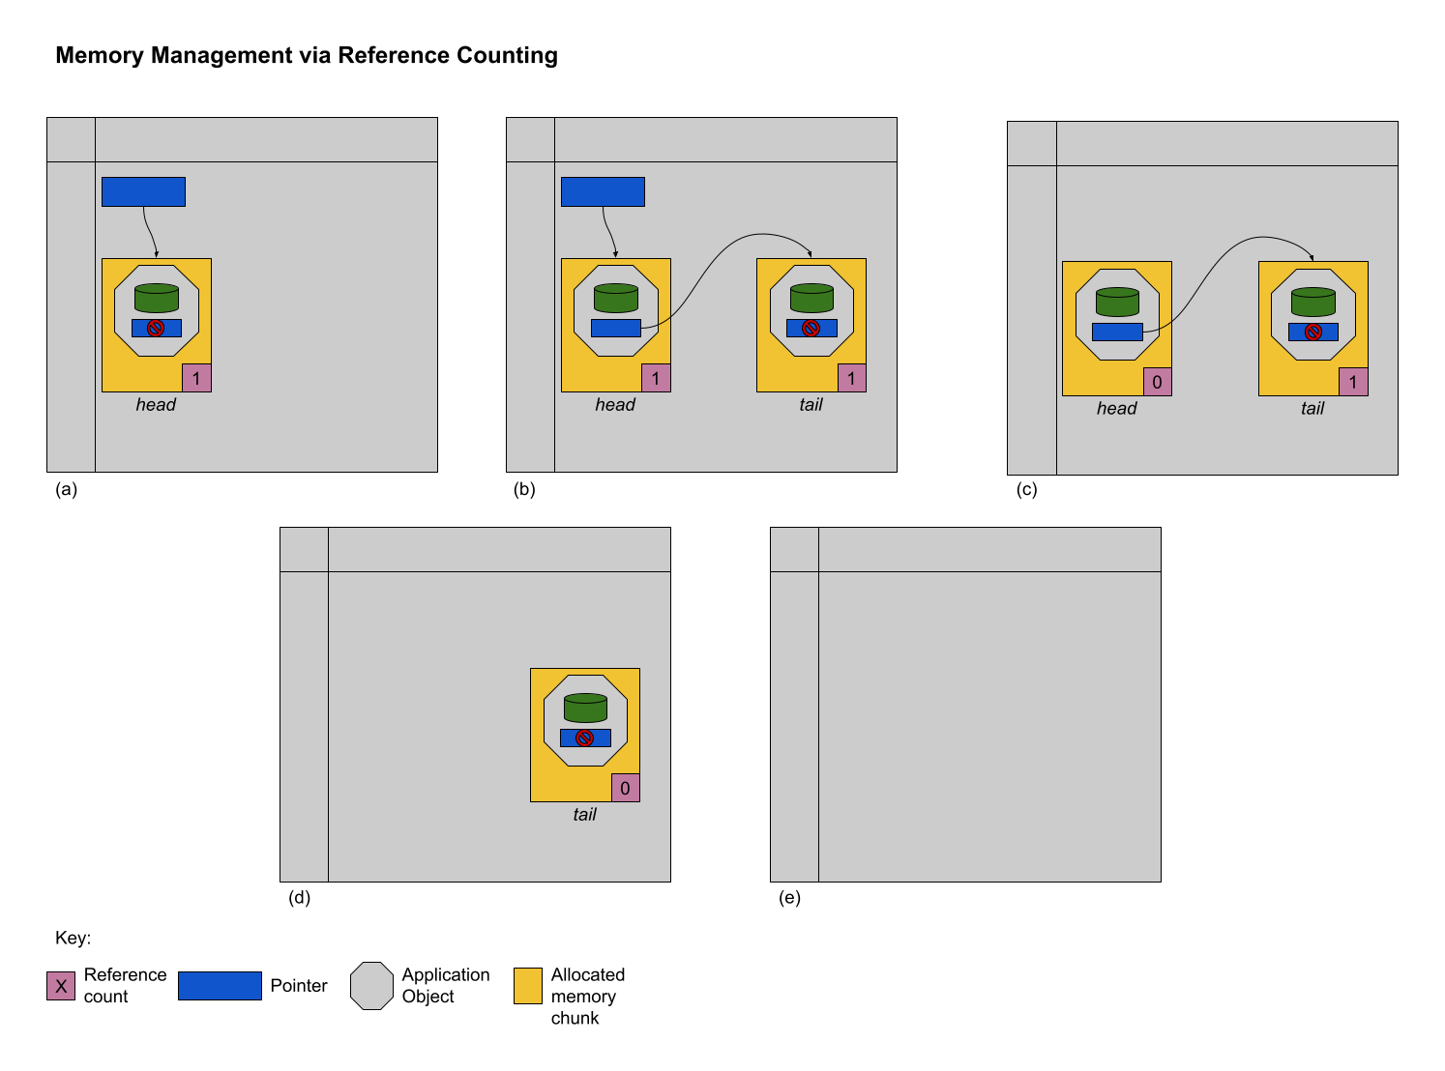
Reference Counting

Slide 21
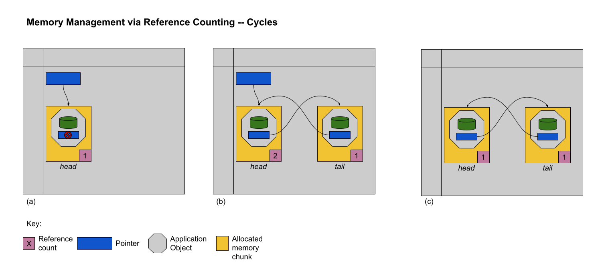
Reference Counting 2

Slide 22
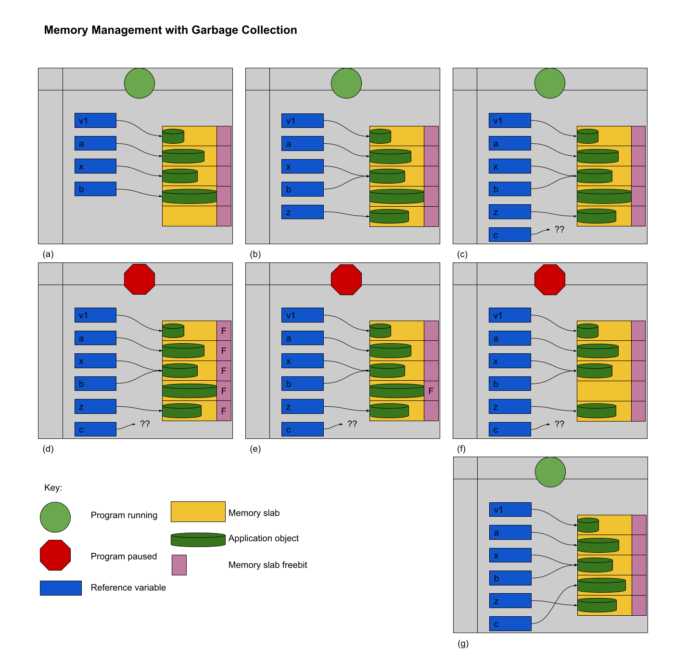
Garbage Collection

